Slide 1


SAT – Pair Programming
Sean Coyan
John Walls

Slide 2


Project Requirements
Create a console application that provides functionality to enroll and schedule students into current and future courses.
Including:
Tracking progress of project
Building relational database
Implementing authentication and identity
Full CRUD functionality
Creating applicable controllers and views

Slide 3
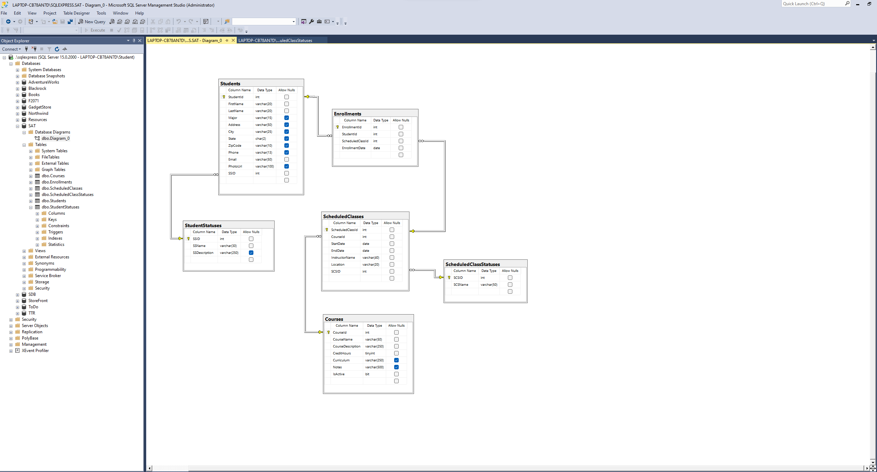
Relational Database
Tables
Students
StudentStatuses
Courses
Enrollments
SheduledClasses
ScheduleClassStatuses

Slide 4
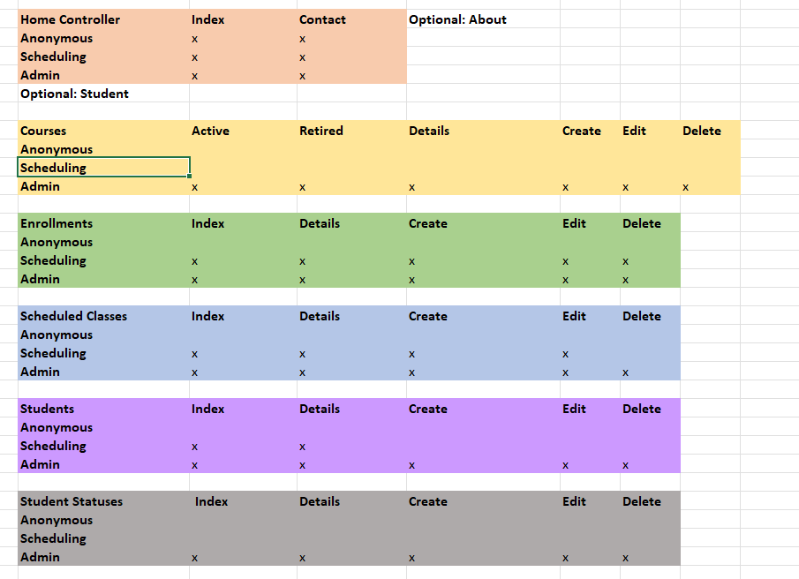
Roles / Identities
Admins
Scheduling Staff
Students / Anonymous
Full CRUD functionality
Ability to view and manage resources
Full authorization
Create, Read and Update
Access to student info
Can’t delete classes or students
See Home and About
Access to Contact form
Able to Register as a new User

Slide 5
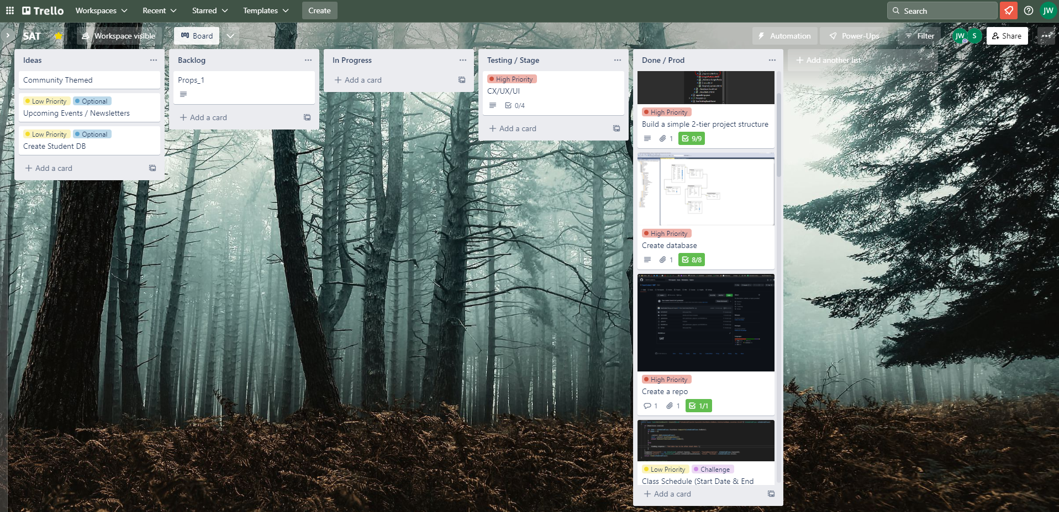
KANBAN Board

Slide 6
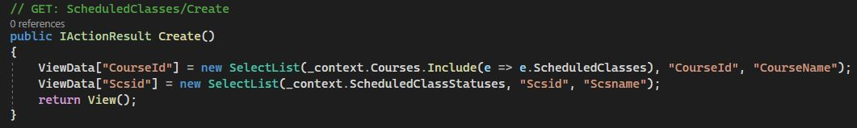
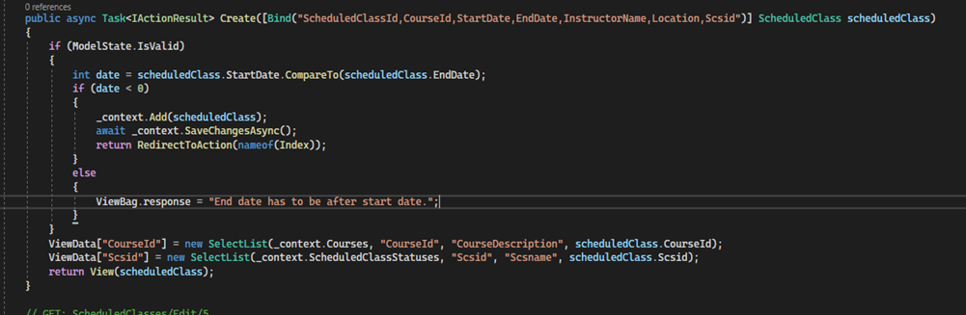
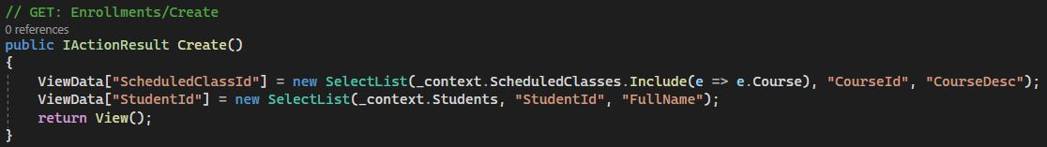
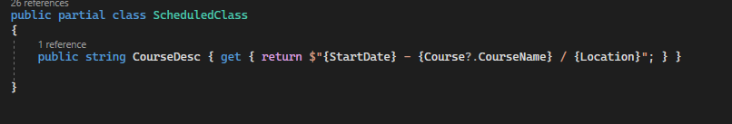
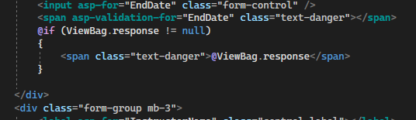
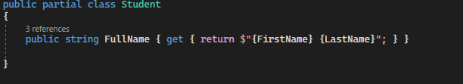
Code Snippets
Custom Properties
Custom Date Picker Logic

Slide 7
Next Steps
To-Dos:
Wish List Items:
Create Tiled Views
TableData Sorting/Filtering
View Formatting
Image Upload Functionality
Teachers/Faculty View

